Slide 1
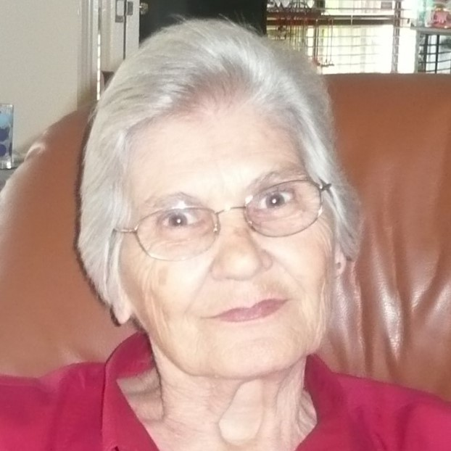

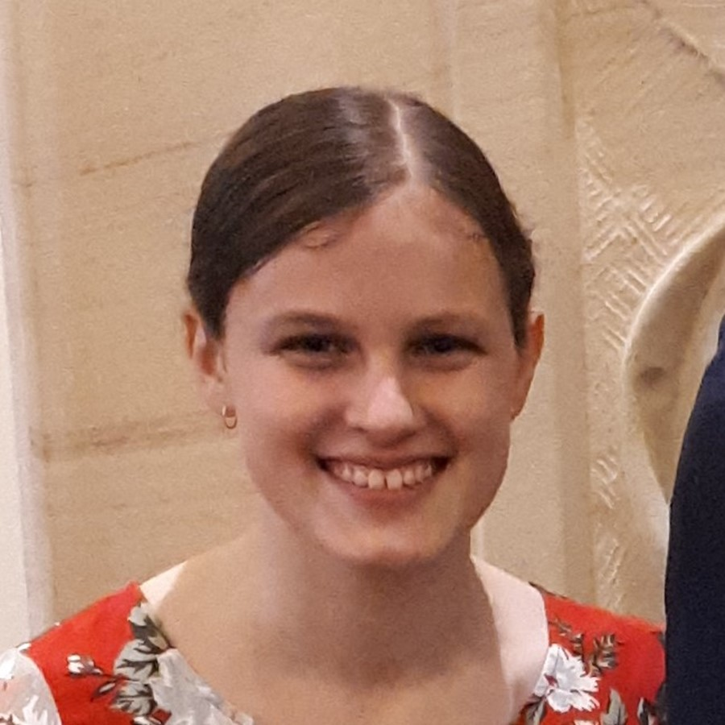
Family Screen
Contact Screen
Requests Screen
Family & Friends
New Contact
2
Eliza
Rob
Friend Requests
ELDERLY
04 032 4354
Make Call
Mary
Add Contact
Edit Nickname
Eliza
Remove Request
Remove Contact
Next Request
Hobbies
Go Back
Go Back

Slide 2
Activity Screen
Hobby Screen
Add Contact Screen
Start an Activity
Add a Contact
🧶
Edit My Profile
Phone Number
043487426
My Hobbies
Knitting
New Hobby
Nickname
ELDERLY
Find a Call
Gran
Knitting
🧶
Remove Hobby
Send Request
Music
🎵
Family
Go Back
Go Back

Slide 3
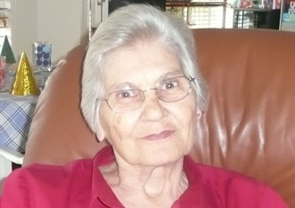
Edit Profile Screen
Add Hobby Screen
Edit your Profile
Add a Hobby
Change Nickname
Woodwork
🪓
Eliza
Reading
📖
ELDERLY
Wine
🍷
Yoga
🧘🏼‍♀️
Keep Changes
More Hobbies
Go Back
Go Back

Slide 4
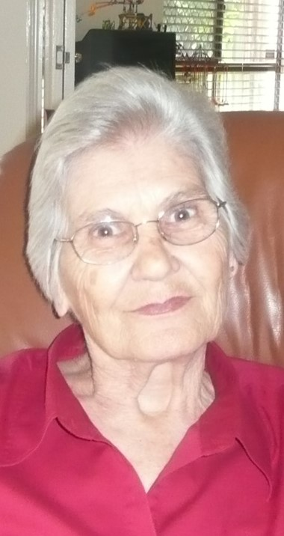

Incoming Call Screen
Family Call Screen
Activity Call Screen
Incoming Call
Eliza
Rob
ELDERLY
Eliza
Answer Call
Place on Hold
Hold
Friend
Reject Call
Hang Up
Hang Up

Slide 5
Contacts Screen
Contact Screen
Requests Screen
Contacts
…
Gran
New Requests
New Contact
2
Friend Requests
RELATIVES
Rob
Rob
04 032 4354
Gran
Call History
Add Contact
Remove Contact
Remove Request

Slide 6
Settings Screen
Call History Screen
Settings
Call History
Retake Picture
4:30pm, Friday
2 Hours
Edit Nickname
1:23pm, 23/08/21
1 Hour
RELATIVES
Notifications
On
10:13am, 23/08/21
Missed Call
2:48pm, 21/08/21
1.5 Hours
Log Out

Slide 7
Incoming Call Screen
Call Screen
Add Contact Screen
Incoming Call
Gran
Add a Contact
Phone Number
043487426
Nickname
RELATIVES
Gran
Gran
Send Request

Slide 8
Log In Screen
New Account Screen 1
New Account Screen 2
Log In
Create an Account
Create your Profile
Phone Number
Elderly
Family
Nickname
0432879841
Eliza
Phone Number
Password
0432879841
BOTH
* * * * * * * * * *
Password
* * * * * * * * * *
Log In
Re-enter Password
New Account
* * * * * * * * * *
Take Picture
Exit App
Back
Next
Back
Create

Slide 9
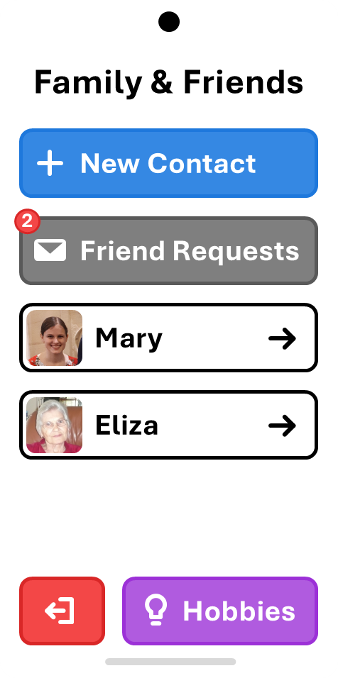
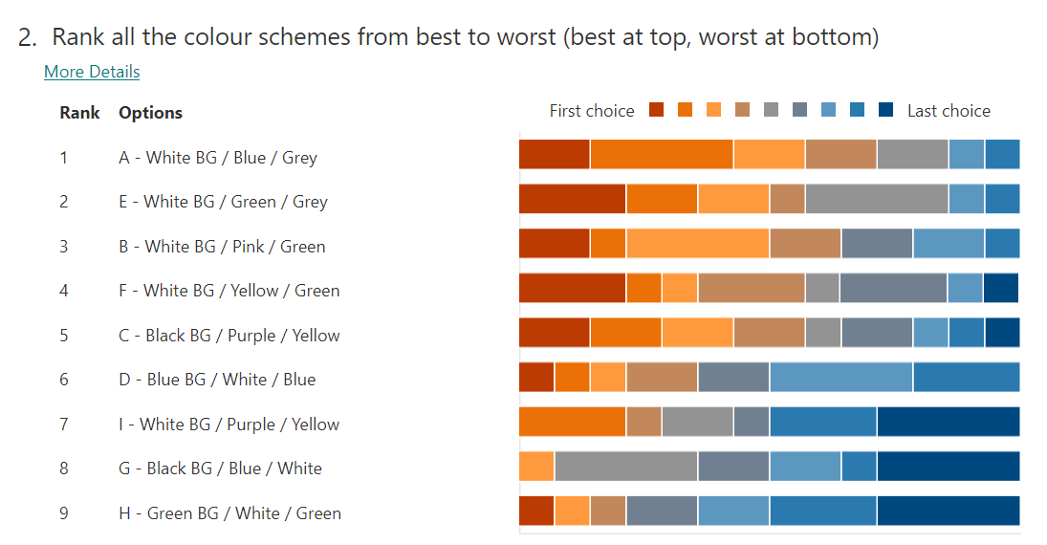

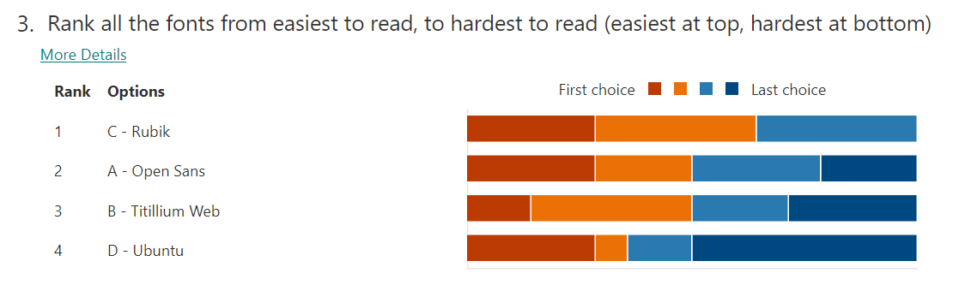
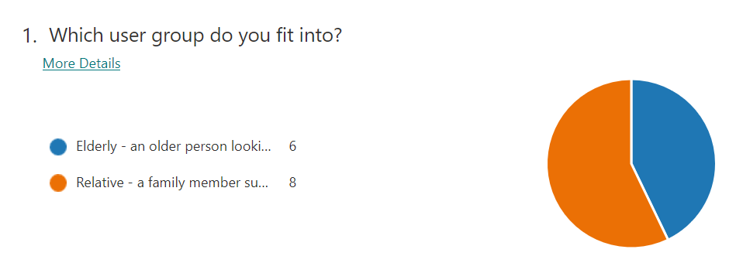

Slide 10
Family & Friends
New Contact
Background Colour
2
Hero Button Colour
Friend Requests
Standard Button Colour
Mary
Negative Button Colour
Eliza
Hobbies/Activities Colour
Family/Contacts Colour
Hobbies

Slide 11
Family & Friends
New Contact
Background Colour
2
Hero Button Colour
Friend Requests
Standard Button Colour
Mary
Negative Button Colour
Eliza
Hobbies/Activities Colour
Family/Contacts Colour
Hobbies

Slide 12
Family & Friends
New Contact
Background Colour
2
Hero Button Colour
Friend Requests
Standard Button Colour
Mary
Negative Button Colour
Eliza
Hobbies/Activities Colour
Family/Contacts Colour
Hobbies

Slide 13
Family & Friends
New Contact
Background Colour
2
Hero Button Colour
Friend Requests
Standard Button Colour
Mary
Negative Button Colour
Eliza
Hobbies/Activities Colour
Family/Contacts Colour
Hobbies

Slide 14
Family & Friends
New Contact
Background Colour
2
Hero Button Colour
Friend Requests
Standard Button Colour
Mary
Negative Button Colour
Eliza
Hobbies/Activities Colour
Family/Contacts Colour
Hobbies

Slide 15
Family & Friends
New Contact
Background Colour
2
Hero Button Colour
Friend Requests
Standard Button Colour
Mary
Negative Button Colour
Eliza
Hobbies/Activities Colour
Family/Contacts Colour
Hobbies

Slide 16
Family & Friends
New Contact
Background Colour
2
Hero Button Colour
Friend Requests
Standard Button Colour
Mary
Negative Button Colour
Eliza
Hobbies/Activities Colour
Family/Contacts Colour
Hobbies

Slide 17
Family & Friends
New Contact
Background Colour
2
Hero Button Colour
Friend Requests
Standard Button Colour
Mary
Negative Button Colour
Eliza
Hobbies/Activities Colour
Family/Contacts Colour
Hobbies

Slide 18
Family & Friends
New Contact
Background Colour
2
Hero Button Colour
Friend Requests
Standard Button Colour
Mary
Negative Button Colour
Eliza
Hobbies/Activities Colour
Family/Contacts Colour
Hobbies

Slide 19
(Fonts won’t display correctly in Teams)
Family & Friends
Family & Friends
A
C
New Contact
New Contact
Family & Friends
Family & Friends
B
D
New Contact
New Contact

